Slide 1
Wait for it…….
Soldiers
War
Discovery
Science

Slide 2
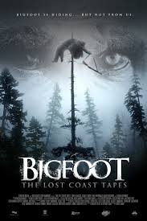
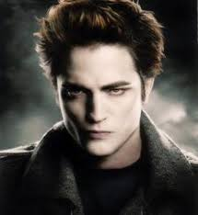
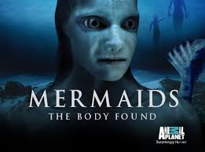
??Science or Science-Fiction??
Pseudoscience: Is a belief or process which masquerades as science. Pseudoscience does not adhere to a valid scientific method, lacks supporting evidence or plausibility, cannot be reliably tested, or otherwise lacks scientific status.

Slide 3
Characteristics of Pseudoscience
Vague
Contradictory
Exaggerated or improvable claims
An over-reliance on confirmation rather than Rigorous attempts at refutation
Lack of openness to evaluation by other experts
General absence of systematic processes to rationally develop theories

Slide 4
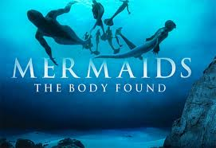
Were you tricked like my students???
REAL
Myth

Slide 5
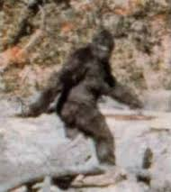
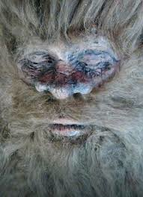
Have you ever believed in BIGFOOT?
Bigfoot is a large bipedal humanoid that is thought to be the link between humans and apes.
Although there have been numerous sightings these creatures are not believed to exist by most scientist due to lack of evidence.

Slide 6
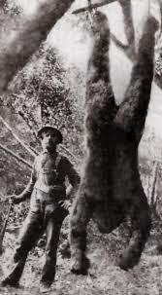
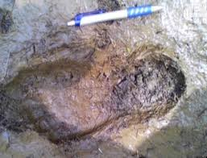
Keep Your Eyes Open
There have been 114 reported sightings in GA, 267 in FL, 243 in OH, and 575 in WA.
Most sighting are classified as misidentifications or hoaxes
Sightings have been documented for over 400 years.

Slide 7
Wait for it…….
Soldiers
War
Discovery
Science

Slide 8
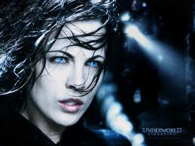
What about Vampires??
Myths about vampires date back to ancient Egypt
The exact origin is unknown
Bram Stoker’s Dracula initiated further interest and belief in the myths
So are there real Vampires?

Slide 9
Real Vampires?
The only “real” vampirism is a psychological condition known as Renfield’s syndrome
Phase 1: auto-vampirism
Phase2:Zoophagia
Phase 3: Vampirism
Vampirism or drinking of blood can be dangerous
Hemochromatosis can result from vampirism

